Slide 1
Works
1
Attention weight heatmap (BRAF)
2
Finish AACR poster

Slide 2
Workflow
a. WSI image preprocessing
d. Biomarker prediction model
- attention-based model (attMIL)
- patch generation
- transformer-based model (transMIL)
- color normalization (Macenko method)
- blurry patch removal (Laplacian algorithm)
e. Model interpretability
- attention heatmap
b. Tumor detection model
- VGG19, ResNet101
- tissue type heatmap
- grad-cam
c. Feature extraction
- ResNet50 self-supervised learning pre-training (SimCLR)
- ResNet50 self-supervised learning pre-training (BYOL)
- ResNet50 self-supervised learning pre-training (MOCO v2)

Slide 3
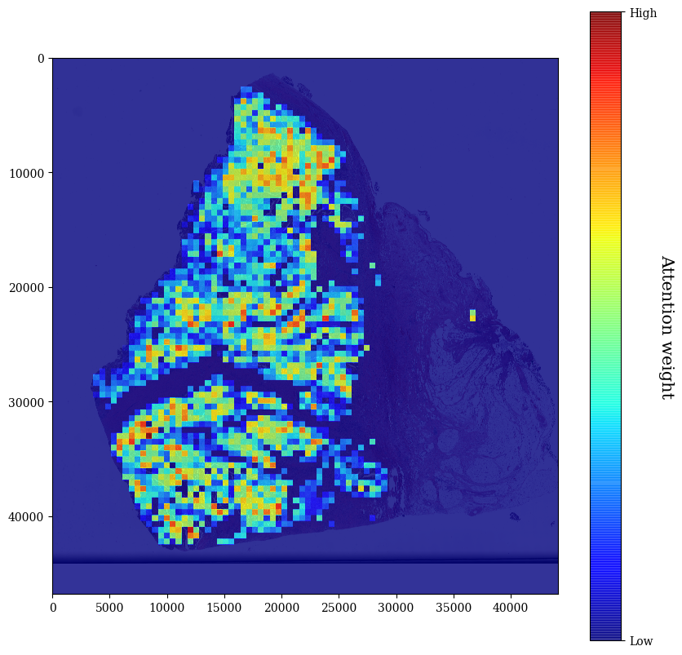
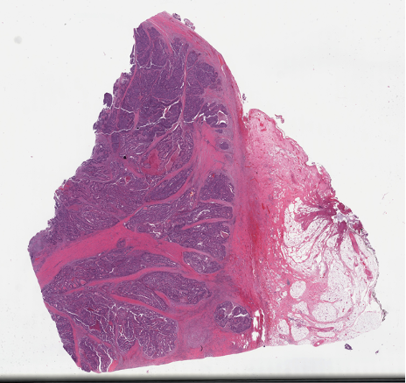
Attention weight heatmap (BRAF)
We use High and Low to represent attention weight because some attention weight of WSI exhibit overconcentration in a specific range
Therefore, I take the log() function of the attention weight to show the distribution of the attention weight apparently

Slide 4
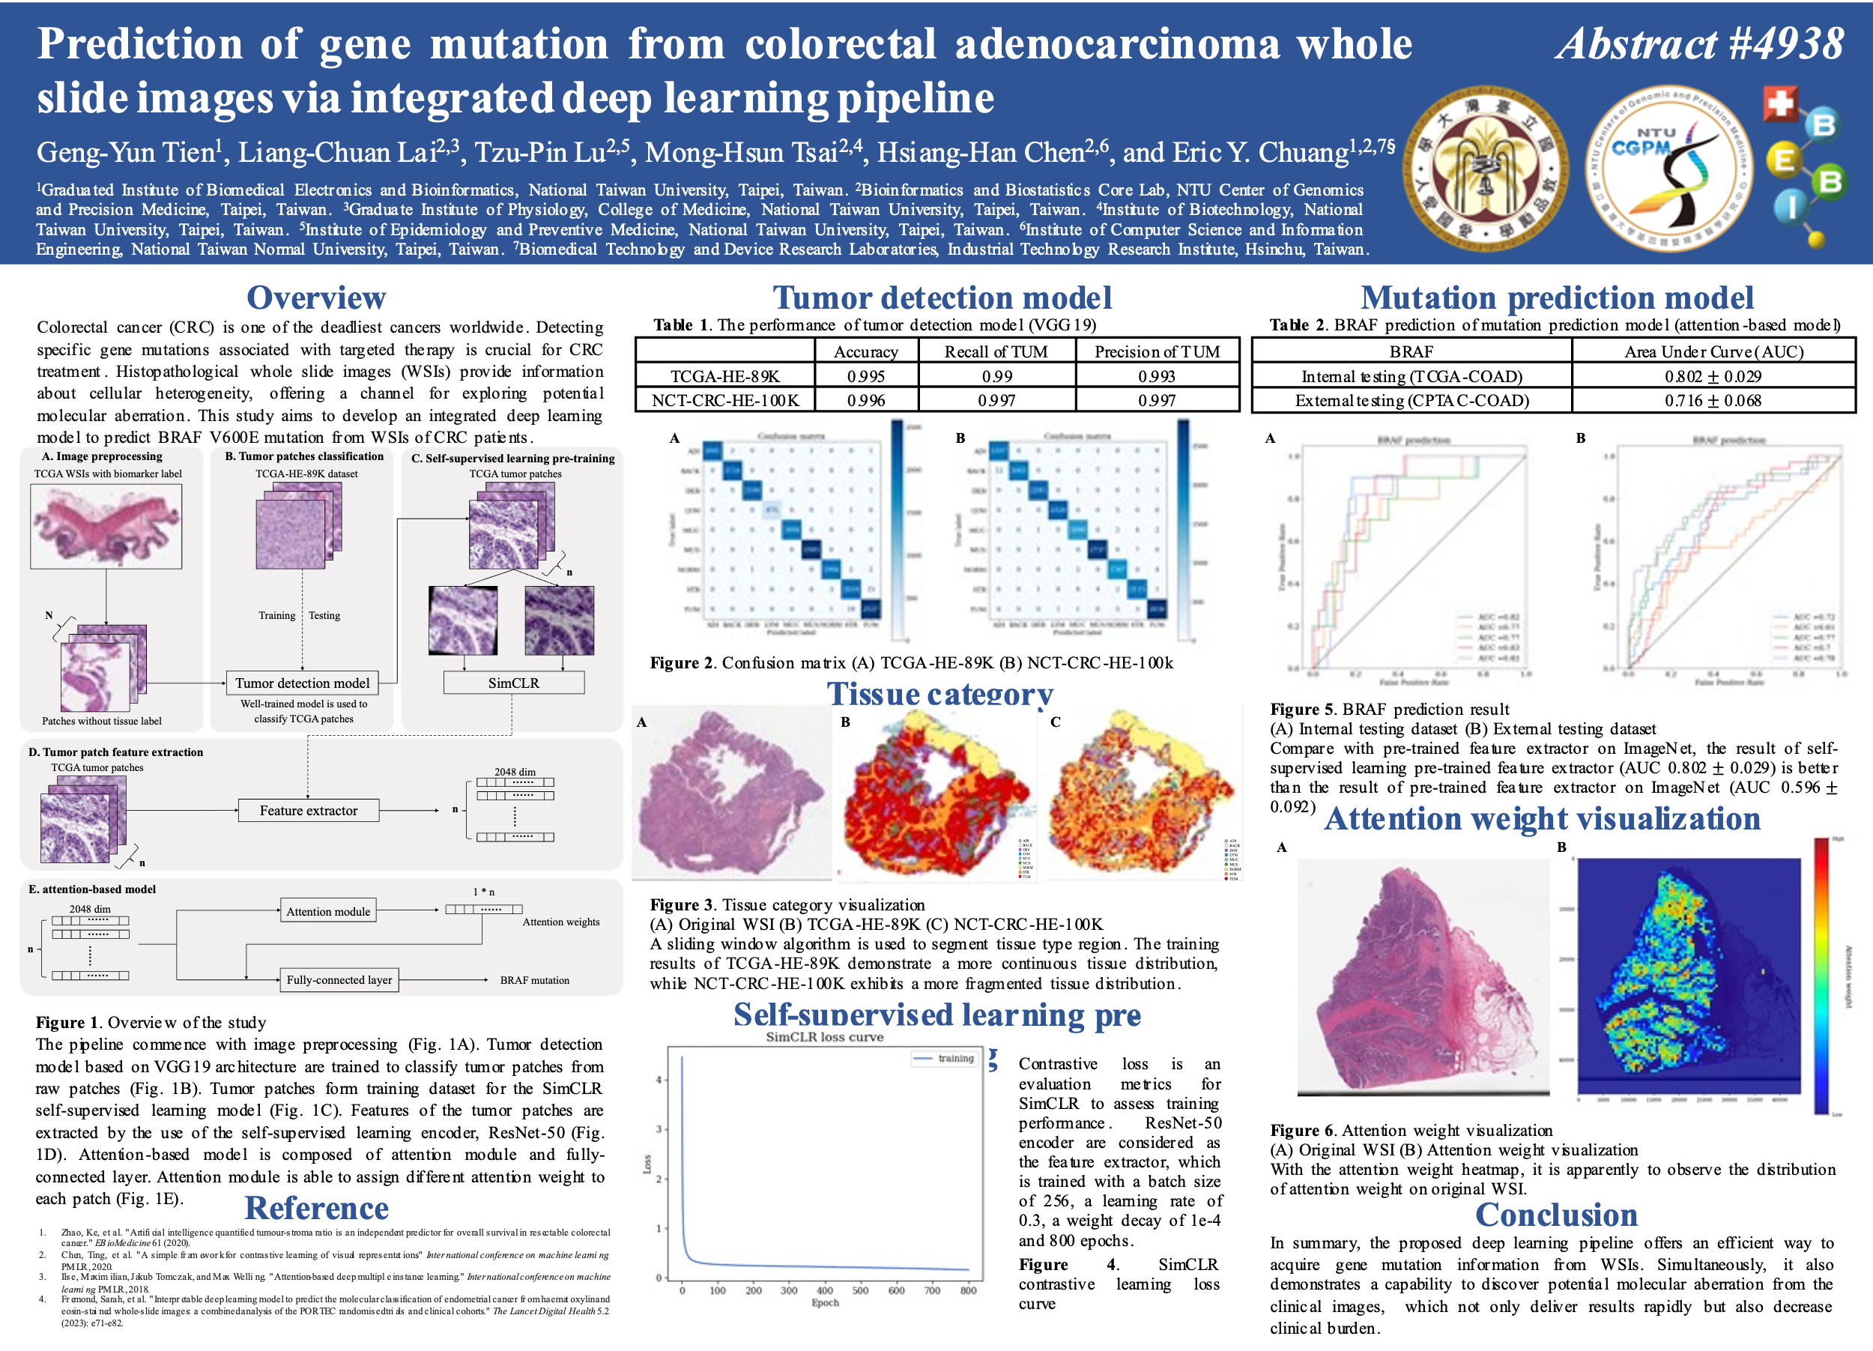

Slide 5
Future works
1
Literature comparison

